Slide 1


Quantum Communications Group
Weekly report
Group Coordinator:
Armando Nolasco Pinto
anp@ua.pt
Group Websites:
https://www.it.pt/Groups/Index/72
LinkedIn: https://www.linkedin.com/company/quantum-communications-group-it-av/

Slide 2
OPEN_CONNECT (App 0) para uma chave simétrica
Mensagem inicial : {"command":"OPEN_CONNECT","data":{"source":"qkd://Application1@aaaaaaaa-aaaa-aaaa-aaaa-aaaaaaaaaaaa","destination":"qkd://Application1@bbbbbbbb-bbbb-bbbb-bbbb-bbbbbbbbbbbb","qos":{"key_chunk_size":4,"max_bps":32,"min_bps":32,"jitter":0,"priority":0,"timeout":150000,"ttl":0},"role":"none","key_stream_id":"14354992-1234-1234-1234-123456789001"}}
Bem Sucedido: {"status": 0, "key_stream_id": "14354992-1234-1234-1234-123456789001"}
Erro: {"status": 2}

Slide 3
OPEN_CONNECT (App 1) para uma chave simétrica
Mensagem inicial : {"command":"OPEN_CONNECT","data":{"source":"qkd://Application1@bbbbbbbb-bbbb-bbbb-bbbb-bbbbbbbbbbbb","destination":"qkd://Application1@aaaaaaaa-aaaa-aaaa-aaaa-aaaaaaaaaaaa","qos":{"key_chunk_size":4,"max_bps":32,"min_bps":32,"jitter":0,"priority":0,"timeout":150000,"ttl":0},"role":"none","key_stream_id":"14354992-1234-1234-1234-123456789001"}}
Bem Sucedido: {"status": 0, "key_stream_id": "14354992-1234-1234-1234-123456789001"}
Erro: {"status": 2}

Slide 4
GET_KEY(Chaves Simétricas)
Mensagem inicial :
command":"GET_KEY","data":{"key_stream_id":"14354992-1234-1234-1234-123456789001","index":0}}
Erro: {"status"2}
Mensagem inicial:
"command":"GET_KEY","data": {"key_stream_id":"14354992-1234-1234-1234-123456789001","index":0}}
Bem Sucedido: {"status": 0, "key_buffer": [194, 204, 98, 113]}

Slide 5
CLOSE (APP 0 e APP 1)
Mensagem inicial :
{"command":"CLOSE","data":{"key_stream_id":"14354992-1234-1234-1234-123456789001"}}
Bem Sucedido: {"status": 0}

Slide 6
OPEN CONNECT (APP 0) para chaves oblívias
Mensagem Inicial:
{"command":"OPEN_CONNECT","data":{"source":"qokd://Application1@aaaaaaaa-aaaa-aaaa-aaaa-aaaaaaaaaaaa","destination":"qokd://Application1@bbbbbbbb-bbbb-bbbb-bbbb-bbbbbbbbbbbb","qos":{"key_chunk_size":64,"max_bps":1024,"min_bps":1024,"jitter":0,"priority":0,"timeout":150000,"ttl":0},"role":"bob","key_stream_id":"14354992-1234-1234-1234-123456789101"}}
Bem Sucedido :
{"status": 0, "key_stream_id": "14354992-1234-1234-1234-123456789101"}

Slide 7
OPEN CONNECT (APP 1) para chaves oblívias
Mensagem Inicial:
{"command":"OPEN_CONNECT","data":{"source":"qokd://Application1@bbbbbbbb-bbbb-bbbb-bbbb-bbbbbbbbbbbb","destination":"qokd://Application1@aaaaaaaa-aaaa-aaaa-aaaa-aaaaaaaaaaaa","qos":{"key_chunk_size":64,"max_bps":1024,"min_bps":1024,"jitter":0,"priority":0,"timeout":150000,"ttl":0},"role":"bob","key_stream_id":"14354992-1234-1234-1234-123456789101"}}
Bem Sucedido :
{"status": 0, "key_stream_id": "14354992-1234-1234-1234-123456789101"}

Slide 8
GET_KEY(Chaves Oblívias)
Após o segundo OPEN_CONNECT serão geradas 128 chaves oblívias, e ocorrerá um GET_KEY com o index da chave respetiva: {"command":"GET_KEY","data":{"key_stream_id":"14354992-1234-1234-1234-123456789101","index":127}}

Slide 9
KEY_BUFFER
{"status": 0, "key_buffer": [81, 4, 69, 17, 80, 65, 17, 85, 64, 21, 17, 85, 1, 80, 84, 17, 17, 16, 16, 21, 69, 84, 65, 69, 21, 17, 81, 1, 5, 81, 84, 80, 5, 65, 5, 16, 80, 16, 4, 21, 69, 69, 74, 187, 234, 187, 190, 254, 254, 234, 239, 235, 251, 170, 191, 234, 170, 187, 238, 190, 251, 234, 175, 190]}

Slide 10
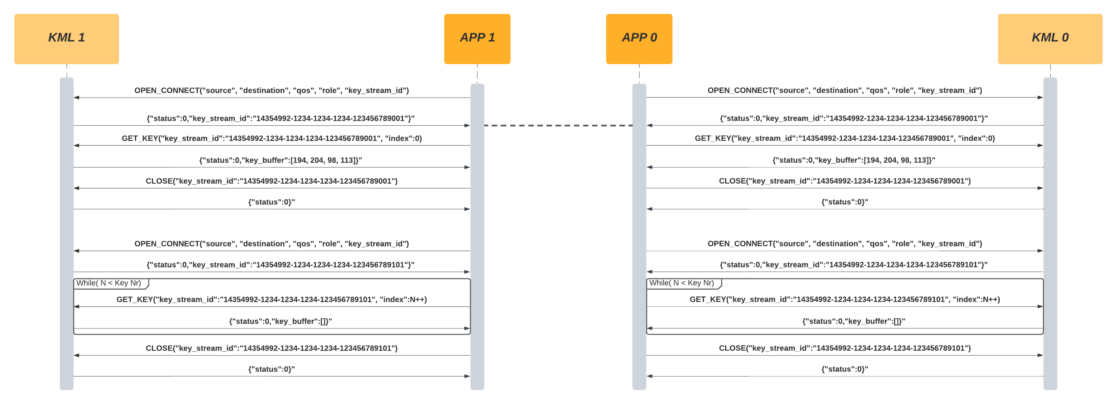
Mensagens trocadas entre App e KML

